Slide 1
IDS 4 PHASE IMAGINE Idea Submission
Challenge : Low cost cooling solutions for warming cities !

Slide 2
Overview of Contents
A Summary Of The Contents That Are Being Explained Further In Slides .
PROBLEM STATEMENT FOR THIS CHALLENGE | Problem Statement Succinctly Describes The Outlines What We Want To Change Or Improve.
ALTERNATIVE TO BE USED | An Alternative Plan Or Tech That Is Different From The One You Already Using. It Can Be Done Or Used Instead Of The Existing Option.
FURTHER EXPLANATIONS | A Molecular Explanation Of Alternatives To Describe A Set Of Facts Which Clarifies The Causes, Context, And Consequences Of Those Its Implementation.
IMPLEMENTATIONS | Planning And Execution Of A Prototype, Concept, Model, Design, Specification & Its Standard Algorithm
SUSTAINABILITY & COST | The Notion Of Easily Interacting With The Environment In A Way That Guarantees Regular Human Behaviour & Won't Alter Working At A Certain Affordable Cost.
Facts, Data And Evidences Used Are Collected From: Science Direct, Dandelion Energy, The BBC , MIT UK & Other Fact Checkers

Slide 3
HOW WE ACCOMPLISHED ALL OF IT.
We fully comprehend the challenge and the problem concerned
We divide the challenges into manageable chunks and allocate them to participants based on specific segments.
Finally, using the information that had been gathered, we were able to identify the precise answer that was needed.
We subsequently conducted more research in accordance with the problem segments individually.
Next, we gathered the information for what was needed using the data and research we had carried out.

Slide 4
Meet Our Team
Our team is a dynamic group of young and enthusiastic individuals who are passionate about solving real-world problems. Let me introduce you to the talented members who make up our powerhouse team:
Lakshya Khare
Team Lead Lakshya oversees all aspects of our project during this phase. His leadership and vision drive our progress. With a keen eye for detail, he ensures that every piece falls into place seamlessly.
Janvi Jain
Bivek Kumar Sharma
Solution and Prototype Architect Janvi’s analytical mind and problem-solving skills shine. She designs elegant solutions and translates them into prototypes. Janvi bridges the gap between theory and practical implementation.
Research Specialist and Team Glue Bivek’s research skills are unmatched. He dives deep into data, uncovering insights that guide our decisions. Beyond research, Bivek holds the team together, ensuring smooth collaboration.
Inshu Jat
Mayuri Bodade
Prototyping Wizard Inshu demonstrates expertise in building prototypes. His coding prowess and creativity turn concepts into tangible designs. If you can imagine it, Inshu can bring it to life.
Information Compiler and Coordinator Mayuri compiled the essential information and coordinated efforts across the team. Her meticulous work keeps us organized and on track. Mayuri is the backbone of our operation.
Our team members are all students at LNCT Group of Colleges, currently studying in the 1st year of the Computer Science and Data Science branch. We believe in continuous learning, adaptability, and pushing boundaries. Our journey is just beginning, and we’re excited to make a difference. 🚀👏

Slide 5
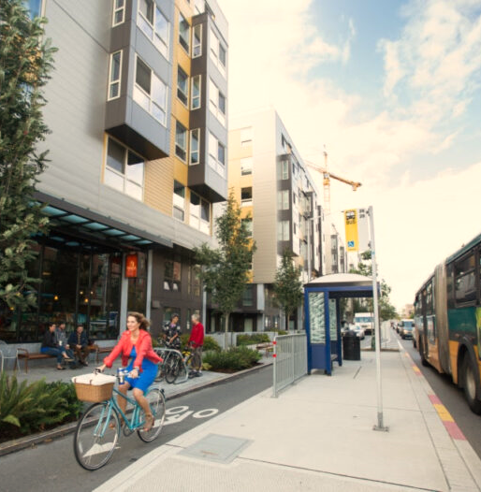
PROBLEM STATEMENT FOR THIS CHALLENGE
01
Challenge : Low cost cooling solutions for warming cities !
Problems faced for warming of urban cities :
On a constantly warming planet, India has a penetration of only 7% when it comes to air conditioning.
With rising incomes, ac demand poised to shoot up.
Estimated 40-60 gw (10-15% of installed capacity) of power will be added only for space cooling.
2.2 billion are already at risk for deadly heat exposure.
Vicious cycle of added cooling capacity leading to higher power demand leading to additional fossil fuel power capacity coming online leading to higher temperatures.

Slide 6
The primary challenge we face from a broader perspective.
TOXICANTS
INCREASING COSTS AND AVAILABILITY
Significant environmental and health concerns have been raised by the role played by hydrochlorofluorocarbons (hcfcs) and chlorofluorocarbons (cfcs) which are highly toxicated gases
Ac and other cooling devices are becoming more and more expensive to use. On the one hand, availability is dwindling dramatically, particularly in urban cities. This also includes growing expenses, the effect on the environment, and energy-intensive cooling.
EXTREME POWER AND LOAD CONSUMPTION
INCREASED DEMAND OF ACs REFRIGERATORS
The increased power use results in higher electricity bills. Excessive load consumption puts strain on servers, networks, and power grids, potentially leading to interruptions and system failures. Ultimately, frequent load swings require extensive maintenance, which exacerbates the problem of system reliability.
Due to high demand, there is a shortage of these devices, which prompts more production and causes carbon emissions and footprints that cannot be removed without causing the environment to suffer two to five times as much damage.

Slide 7
SOLUTIONS NEEDED FOR PROBLEM FACED
01
02
03
04
05
Reduction
Resources
Budget
Diminishment of carbon emissions
Decrease in the load and use of energy
Decrease in non-biodegradable substances
Decrease in the area's overall stability
In basic terms, the goal is to lower carbon emissions, utilise natural cooling methods to chill areas without producing excessive heat, and create a perfect temperature equilibrium.
Minimise the overabundance of resources.
avoid employing toxicated substances.
extended period for material degrading process
potential to be used for a longer period of time.
In basic terms, the goal is to use minimal processed resources without employing the toxic substances and that also provide the longer span without degradation process.
economical solution for implementation.
able to change out the old equipment for a specific price.
Low applied raw material (ARM) cost.
can provide equivalent stability and useful outcomes.
In basic terms, the goal is to Reduce the cost and make it as affordable as feasible so that the previous approaches can be readily changed without incurring any further expenses.
Application
Sustainable
easily included into the current structure.
straightforward to outsource without a lot of technical expertise.
can be utilised with the same obsolete technologies.
easily manufactured and don't require a lot additional application.
In basic terms, the goal is to find the solution which is easy to apply on existing structures and buildings without additional application .
is possible to create using materials derived from natural sources.
can be used for a longer period without deteriorating or breaking down.
can be easily maintained in the current building structure.
works in many environments with little modification.
In basic terms, the goal is to came up with solution which is easily maintain and can sustain over a period of time without prior maintenance and defacts.

Slide 8
02
ALTERNATIVE THAT NEED TO BE USED

Slide 9
The Materials We Use for SOLUTION
We have successfully extracted the materials that this project team will use to solve the problem. Our team has created and chosen the materials that address the issues and difficulties that have been previously discussed in the project and that are sustainable, affordable, and meet other requirements.
Phase change materials (PCM)
Terracotta &
Laterite
Geothermal
Cooling
It is a substance which releases/absorbs sufficient energy at phase transition to provide useful heat or cooling. Generally the transition will be from one of the first two fundamental states of matter
Water passes through the terracotta & laterite tubes, facilitating evaporative cooling
Air is cooled when it passes through and comes out and stays cool like water in an earthen pot naturally without any chemicals and other toxicants used for cooling.
A geothermal cooling system is a type of cooling system for buildings that will use a heat pump to transfer heat to the ground taking advantage of the relative constancy of temperatures of the earth through out the seasons.

Slide 10
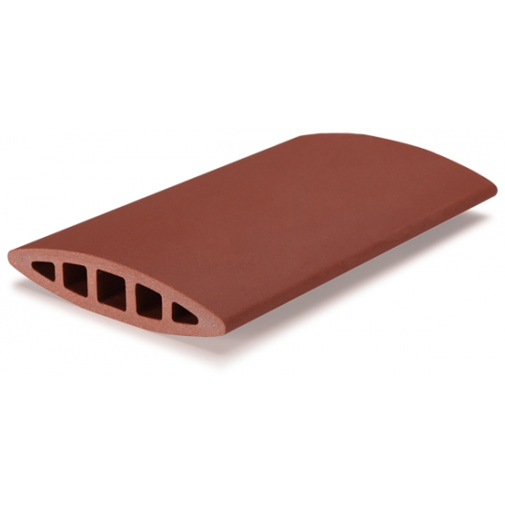
Terracotta / Laterite
Product is in leaf shape of louvers which are hollow inside for water flow (cold) that cause water transpiration from outer surface.
These louvers are made up of CLAY and NATURAL COMPOUNDS in specific ratio then backed at 1200°C.
Low cost effective solution for exterior walls and window of existing building and structures.
Their firing process ensures good flexural strength, freeze-thaw resistance, and fade-proof properties.
Costs less the Rs.99 per louver and low cost to install and transport too.
Can reduce up to 15-20 °C individually (with regulated flow of water at given temperature and conditions)
Sometimes it is also implemented inside the area/room to achive the significant temperature.

Slide 11
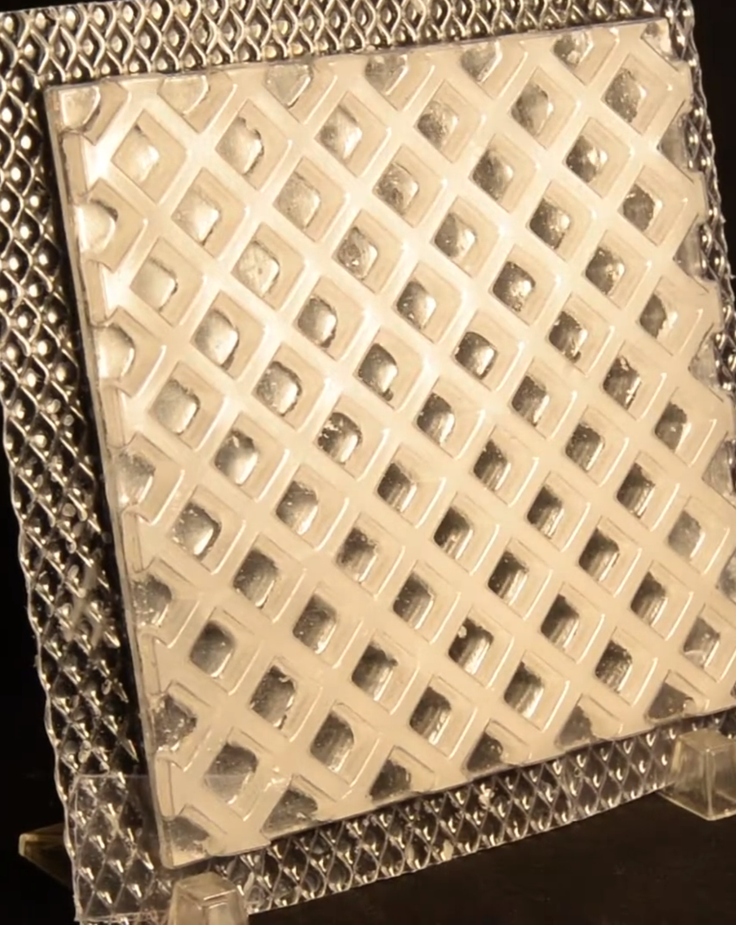
Phase change materials
This material is composed of several raw materials that are insulated with PCM inside to allow for continuous absorption of heat during the day to cool the surroundings and release of heat during the night to maintain a temperature balance in nature.
These materials are mostly composed of natural compounds and insulated PCM with an exterior layer of aluminium as a sheet.
economical fix for the interior walls and cellings of already-existing buildings and structures.
They feature class A fire safety grade, strong flexural strength, water resistance, five stars for flame protection, and a smoke generation index of five.
less expensive than Rs. 199 per square foot, with less installation and manufacturing costs.
can drop by 12 to 25 °C individually depending on the specific raw material used.
Degrade and decompose only 2% over 100 year of time span .

Slide 12
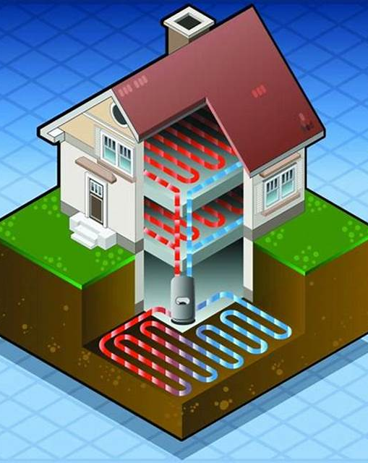
Geothermal Cooling
Geothermal cooling uses the earth's stable subsurface temperature to efficiently cool buildings. Heat from indoor air is absorbed and transferred to the cooler ground through underground pipes. This cooled fluid then cools indoor air before circulation. Geothermal systems offer consistent performance and lower energy consumption, making them a sustainable cooling choice.
This method is used to cool air inside a closed structure via regulating air from insde to ground organically by pumping system.
Cost effective solution for providing constant cooling to structures.
This method require pipes, air and heat transfer pumping system, ground insulating pipes and low cost construction under ground.
Costs at initial stage the working principal takes 2-5 unit of electricity that can exchange up to 5-6 unit of heat into structure’s outlet.
Can reduce up to 5-20 °C individually (with regulated flow of air at different conditions respectively)

Slide 13
03
FURTHER MOLUCULAR LEVEL EXPLANATIONS :

Slide 14
OUR AIM
The aim is to combine the carefully outlined materials to solve and create an efficient low-cost cooling solution option that can implemented without altering or replace existing building structures on the urban landscape also without incurring additional costs. The idea is to implement a solution that can significantly reduce the temperature of a particular area as well as of the environment, which has been harmed over time by extreme carbon emissions. in order to lessen this, we came up with three useful materials that may be able to change the standard cooling system that emits carbon emissions and uses a lot of power while also creating hazardous toxicants. with the indulgence of science and technologies combined with sustainable and natural solutions. (The solution is targeted to building and houses in urban cities)
FURTHER WORKING OF THIS SOLUTION INDIVIDUALLY IN WHOLE SYSTEM :
Terracotta & Laterite:
it will act as a 1st ventilation layer in building providing cold moist to flowing air from outside that will be cooled via getting in contact with its surface.
Initially it will reduce the temperature of inside of a building that can be further reduced by other methods .
This layer cover the open area like windows, balcony, terrace , sheds etc that are being exposed to environment directly.
Cold water is flowing inside the louvers uses 2-5 u/per day and can be cold via geothermal cooling system.
In this layer the louvers are placed at certain angle to increase the time of air flowing from its surface so that it can be cooled for longer time .
Phase change material:
This layer will be 2nd part of the process in which the temperature and the cool air that has been passed inside get further cooled by this phenomena of state changing it will reduce temperature and make the surrounding cool.
This layer will cover the wall and celling of the building or area that needs to be cooled .
It do not use electricity its totally scientific process that do not produce any toxicants and its totally odourless, smokeless & fire proof.
Geothermal Cooling:
This setup needs bit of construction and bit of initial cost to run but its effective solution to regulate the cool air significantly in whole
area and maintain temp balance.
This system will be the 3rd layer where the already cooled air will get further regulated and distributed and also get re cooled with the help
of ground heat absorption by flowing air under 10 feet under ground and redistribute the air through ventilation , also this system will
regulate the water flowing in louvers and maintain the equilibrium and cycle of air conditioning.
This layer uses 2-5 u/day in addition to exchange 6-8 units of thermal energy in building.

Slide 15
The functioning of these methods are as follow:
TERRACOTTA & LATERITE:
This material will use to maintain the coolness and cold humidity with the help of ventilating air coming from hot dry outside environment to inside to structure and getting in contact with the louvers surface that are being shapes as leaf for better evaporation cooling through micro pores that cool the air with water flowing inside hollow structure , it do not use any electricity to run except the water flow inside , it can be applied to any open parts that is in open contact with outside world or can replace traditional glasses walls this can potentially exchange 99x times more heat then regular glass walls and cause cooling in temperature that can be stay longer.
PHASE CHANGE MATERIALS:
As a cool-temperature interior material, it will absorb heat during the day and transform into a liquid, which will lower the temperature. At night, it will release the heat it has stored and transform back into a solid to maintain equilibrium, which may help lower the temperature without requiring the use of an external energy source. The entire procedure will contribute 30% less to the reduction of carbon emissions and footprint in the environment. The 1.5-inch surface, which is comparable to a 15-inch ordinary open concrete surface, has the ability to exchange heat energy while providing cooling.
GEOTHERMAL COOLING
This form of cooling setup costs more than other solutions because it uses pumps, pipes, fans, and other equipment. It requires 2 to 5 electricity units to regulate the environment, but it produces 6 to 8 units of cooling efficiency and maintains the equilibrium without the need to add any hazardous materials from or in the nature. This has the ability to cut 5 to 10% of the heat energy coming from the outside and may be used in newly constructed buildings at about 60% of the price of a conventional cooling system.
TOGETHER THESE PARTS COMBINING IN A SYSTEM AND SETUP:
This system will produce a useful solution that will gradually lower the temperature and keep it there. The louvres layer provides aerodynamic design to control air flow over the cycle, it will also continuously reducing temperature by phase changing material, maintain the building's air flow through geothermal cooling and ventilate it using louvres. These solutions together can decrease cooling times by 5-10%, drop temperature to 20-30 along with increase air flow by 50% in the building the setup remain carbon dioxide free and sustain over longer periods of time and aid in climate control targeting to any property or building in an
Urban area will be able to drastically reduce its cooling costs with little to no electrical consumption.

Slide 16
22-30%
50-65 units/day
97.9%
By implementing these solutions together we’ll get significant reduction in electricity and malicious consumption that were being extensively adds to the buildings running cost and reduce it up to approximately:
Cost is calculated on the basis of data collected by various factchecker and universities.
unit are calculated on the basis of 1x3 ton ac being used 24h daily.
Also can reduce carbon emmision and toxicants productions
data is calculated on the basis of data collected by various factchecker and universities.

Slide 17
FURHTER BREAKDOWN
Layers | Intial temp Approx | End temp Approx | Running Resource | Electricity Consuptions | Daily running cost
Terracotta & Laterite: | 45-48°C | 32-35°C | One time : clay louvers, metal holders and shutters Running time : Water flow | - | -
Phase change material: | 32-35°C | 26-30°C | One time : PCM and Coveringsheet Running : N/A | - | -
Geothermal Cooling | 26-30°C | 20-24°C (Constant) | Onetime : Machine & System Running: electricity and ventilation system | 2-5 u/day (for 15x15 feet area) | Rs. 20-40/day

Slide 18
04
IMPLEMENTATIONS:

Slide 19
IMPLEMENTATION PROCESS
The material will get out sourced from various area and being collected to required area
Combining the system & product at required places and part of building
Testing the product with working test and make changes to the required areas
Compiling the resources and applying the aerodynamic and scientific design for potential working
Completing the process and finalising the design with all other working aspects of this system
Will check the working of all the plan and the actual design figure out any errors and misworking
Finally combine the whole system check the all parts working and ensure the seemless working
Calculate the saved carbon emission and total saved carbon footprint that has been reduced

Slide 20
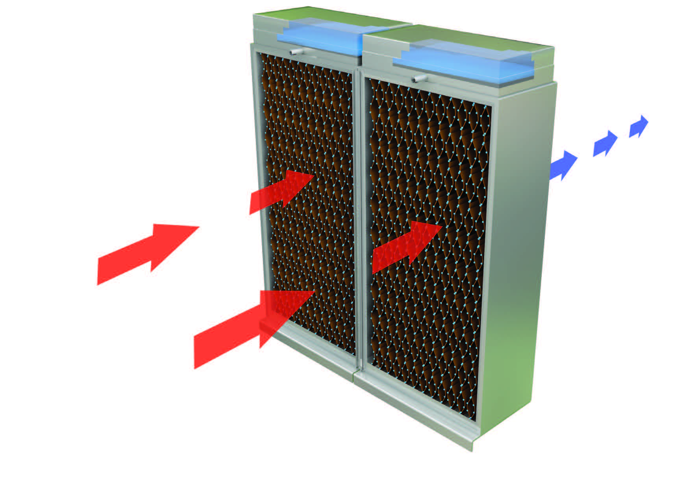
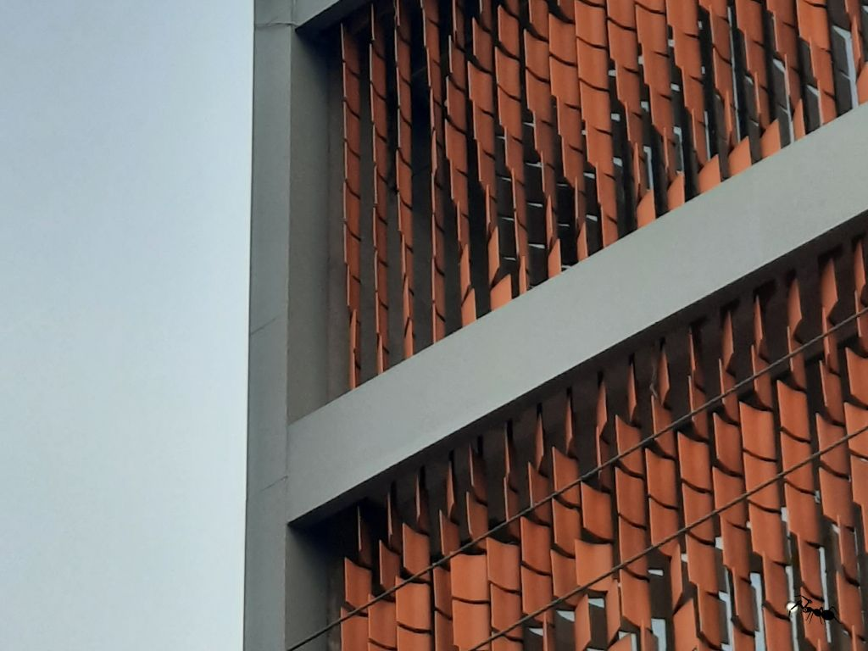
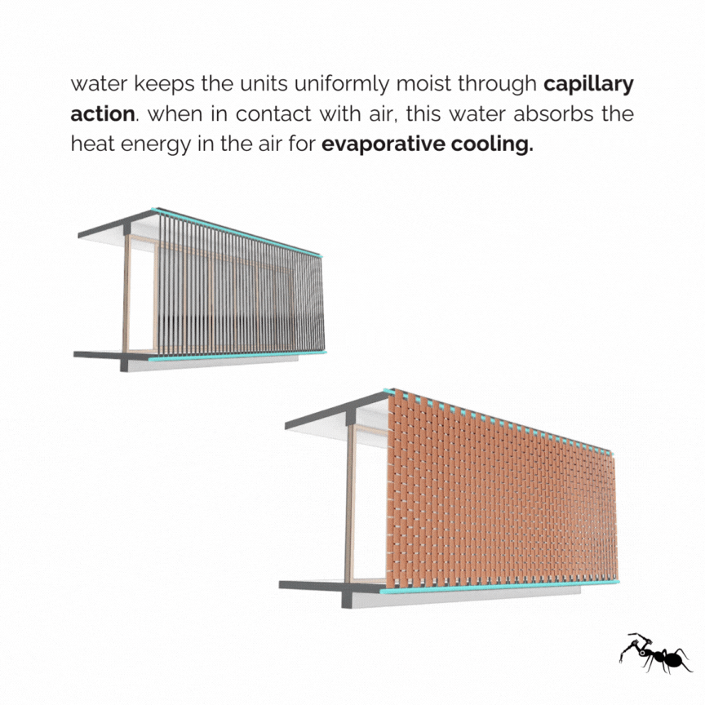
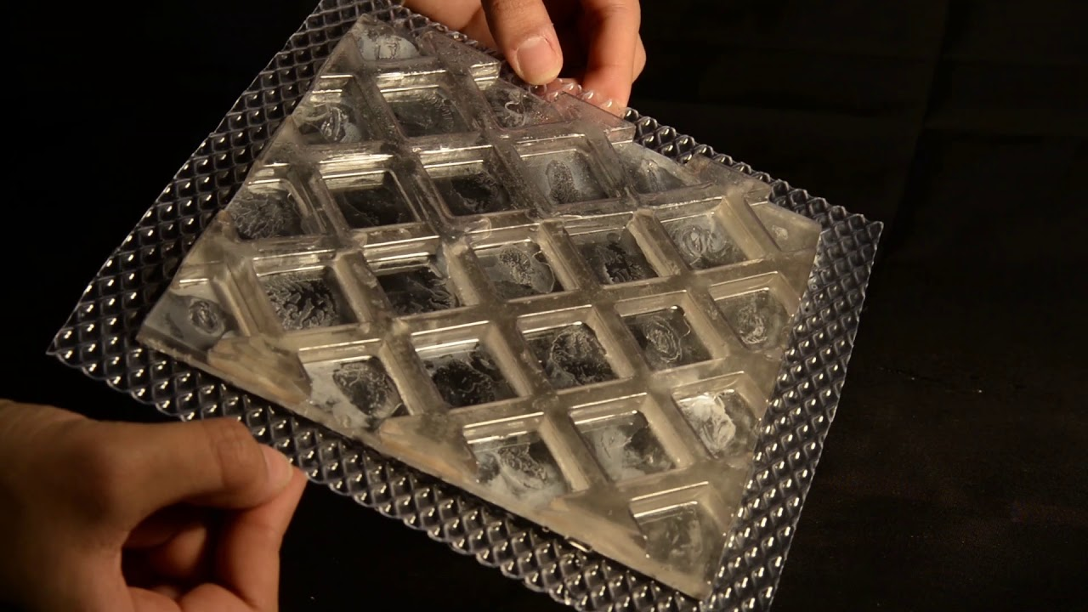
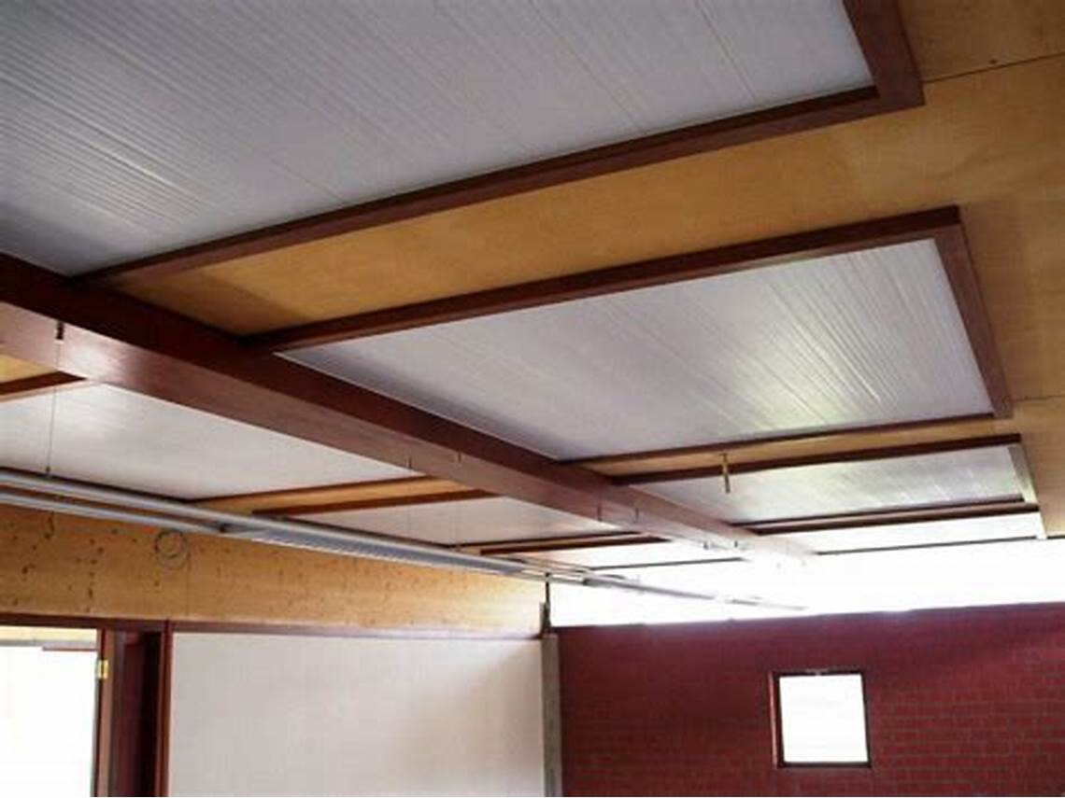
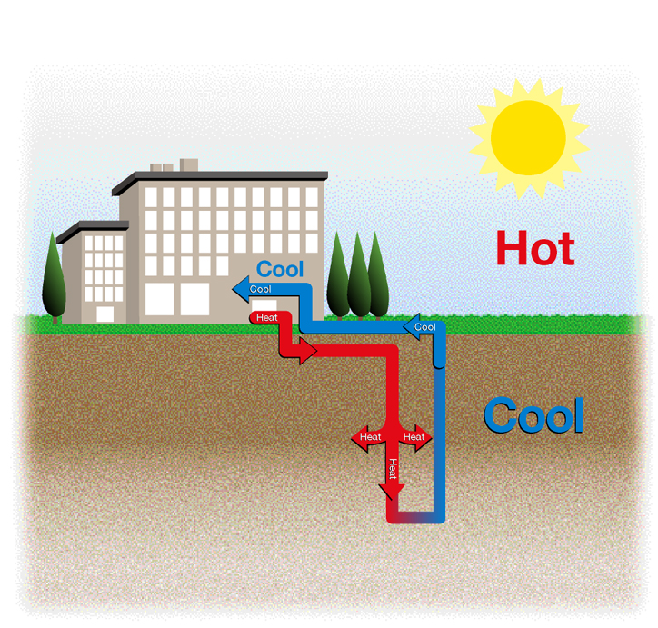
PHOTOS RELATED PARTS OF WORKING SYSTEM
This photo shows the 1st layer and ventilation layer for windows that is been implemented and over the existing structure and the flow and aerodynamic moving design of the hollow louvers.
This photo shows the 2nd layer and PCM insulated layer for walls and celling that has been implemented to same structure.
These picture shows the 3rd layer’s phenomena and pump that has been installed in small space without changing much structure

Slide 21
05
SUSTAINABILITY & COST EFFECTIVENESS :

Slide 22
100+ years
Once after bearing initial cost and time of implementation this system and setup can last upto :
Data is been calculated according to material used and also the data given by factcheckers
This system is self healing and non degradable as well as non decomposable (in open working system) this system setup doesn't need any prior maintenance and technical issue the working and application process doesn't need any extraordinary skill and technical knowledge.
The sustainability of this setup is better then traditional way and is 40-60x times better then other carbon emitting devices.
This device setup do not produce or does give very minimal carbon footprint which help in covering up the previous damage.
This setup is also very minimal and easily producible, and the initial cost can also be brought down after mass producing the raw parts.
DEVICES | CARBON EMMITION | TEMPRATURE
TRADITIONAL | 14-35 Pounds/day | 10-30% drop when running
THIS SYSTEM | 0.01 Gm/day | 20-40% drop constant and significant

Slide 23
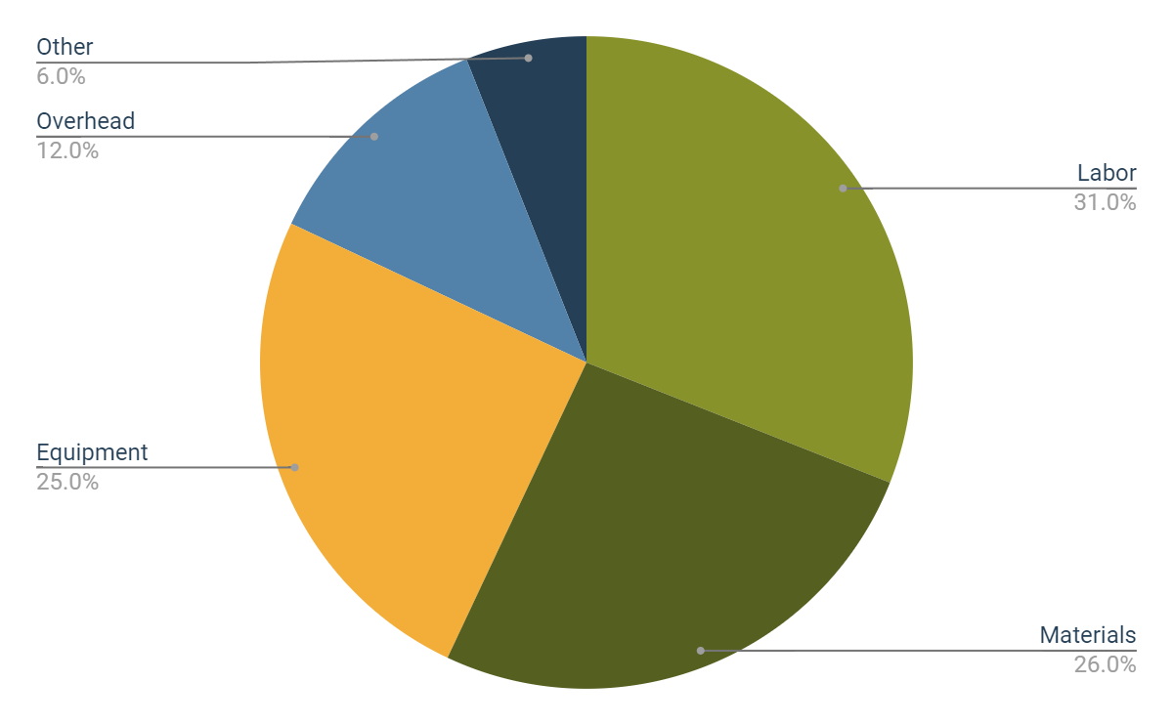
SOLUTION IMPLEMENTATION EXPENSES
Labor
Materials
Equipment
Overhead
Other
This data is not fixed and can be changed due to production cost and varies city to city and depending upon the transportation cost
In wider view the data is considered as mid size urban city

Slide 24
INITIAL IMPLEMENTATION COSTS BREAKDOWN
Resource | Utilization | Costs (APPROX)
Labor | 31% | Rs.18600
Equipment | 25% | Rs.15000
Materials | 26% | Rs.15600
Energy load | 4% | Rs.2400
Overhead | 8% | Rs.4800
Other | 6% | Rs.3600
40-60K
UNDER 100h
TOTAL INITIAL COST
TIME OF IMPLEMENTATION
This table is consist of the total approx. initial cost to implement the cooling solution in a 15x15 feet area
Cost effective solution for providing constant cooling to structures in replacement to traditional way of cooling with natural cooling system.
This system of cooling require material that need to be out source from various different vendors and places.
The cost comparing to traditional way is as low as 8-10% and give solution for cooling 5-15% more effectively also reduce working cost.
80% Power saving then classic AC’s and other way of cooling

Slide 25
THANKS!
TO GET CONNECTED:
lakshyakhare226@gmail.com
www.lakshyakhare.com
www.linkedin.com/in/lakshyakhare

